Slide 1

Quiz Exam Project using Java

Slide 2


Submitted By
Name | Id
Md.Ashikur Rahman | 21225103471
Abdullah Al Mahmud Joy | 21225103506
Kashpia Alam | 21225103487
Mirza Niaz Morshed | 21225103467
Ayesha Siddika Esha | 21225103495
Supervised by
Md. Mahbub-Or-Rashid Assistant Professor, Department of CSE, BUBT

Slide 3
ABSTRACT
In this paper, we are developing a Quiz Application in Java that aims to provide users both teachers and students with an
interactive platform to participate in quizzes on various topics. The application will be designed to offer a user-friendly experience while efﬁciently managing questions, answers, and scoring all while managing a secure database to store our data and results in a user friendly interface.

Slide 4
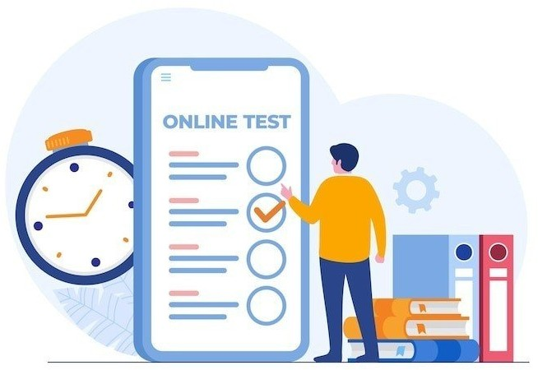
Introduction
The purpose of this project is to create an accessible and enjoyable Java Quiz Application to enhance learning experiences, providing a user-friendly platform for quizzes on diverse subjects. The goal is to make learning fun and testing knowledge a breeze!

Slide 5


Background
The Java Quiz Application project responds to the changing educational landscape, ampliﬁed by the challenges of the COVID-
19 pandemic. With physical classrooms constrained due to safety measures, there is a heightened need for an online, interactive learning tool. The limitations imposed by the pandemic underscore the importance of virtual solutions, where a dynamic quiz platform becomes a valuable educational resource. This project aims to address the educational void created by COVID-19 restrictions, offering a versatile and accessible avenue for knowledge assessment and reinforcement

Slide 6


Objectives
The primary objectives of the project are as follows:
Create a User Interface: Develop an intuitive user interface that allows users to access quizzes, answer questions, and view results.
Question Management: Implement a system to manage questions, including adding, editing, and deleting questions.
Scoring System: Design a scoring mechanism that calculates and displays users’ scores based on their answers.
Multiple-Choice Questions: Support multiple-choice
questions with options and the ability to select a single correct answer.User Authentication: Implement user authentication to ensure secure access and personalized user proﬁles.
Timed Quizzes: Provide an option to set time limits for quizzes, ensuring a challenging and engaging experience.
Feedback: Enable users to receive feedback on their answers, showing correct answers for incorrect responses.
Admin Panel: Develop an admin panel to manage quiz content

Slide 7


Methodology:
1. Index Class:
Purpose: Represents the main entry point of the application.
Functionality: Displays the initial landing page with options for teachers and students to access different sections.

Slide 8

2. Login Teacher Class:
- Purpose: Allows teachers to log into the system using unique credentials.
- Functionality: Validates teacher login credentials and grants access to the admin dashboard upon successful authentication.

Slide 9

3. Admin Home Class:
Purpose: Exclusive access for teachers to manage and customize quizzes.
Functionality: Provides a secure space for teachers to add/delete questions, view student results, and navigate to other admin-speciﬁc functionalities.

Slide 10
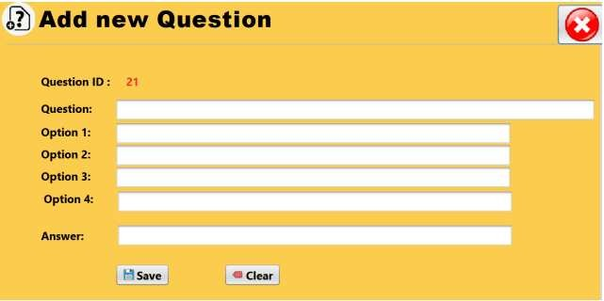
4. Add New Question Class:
Purpose: Allows teachers to add new questions to the question bank.
Functionality: Provides a user interface for teachers to input and submit new quiz questions, ensuring seamless integration into the question database.

Slide 11
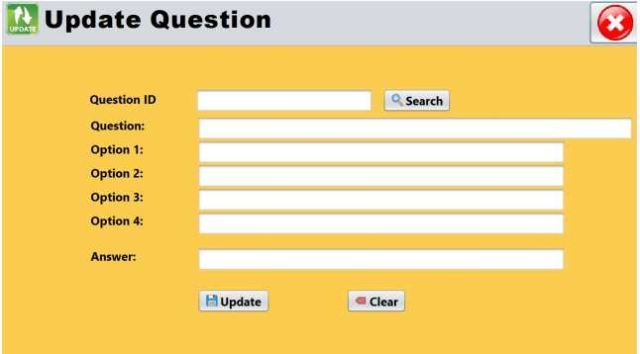
5. Update Question Class:
- Purpose: Permits teachers to modify existing questions in the question bank. - Functionality: Offers a platform for teachers to select and edit questions.

Slide 12
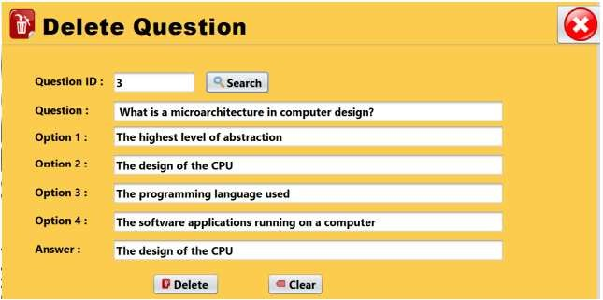
6. Delete Question Class:
- Purpose: Enables teachers to remove speciﬁc questions from the question bank. - Functionality: Provides a mechanism for teachers to maintain and update the question database.

Slide 13
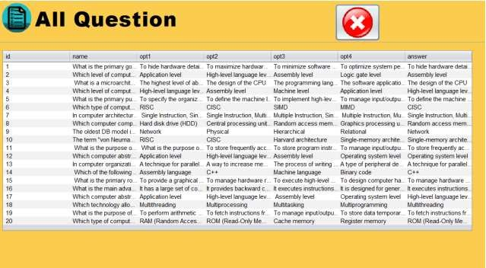
7. All Question Class:
- Purpose: Displays a list of all available questions in the database. - Functionality: Allows teachers to view and manage the entire question bank for quiz customization.

Slide 14
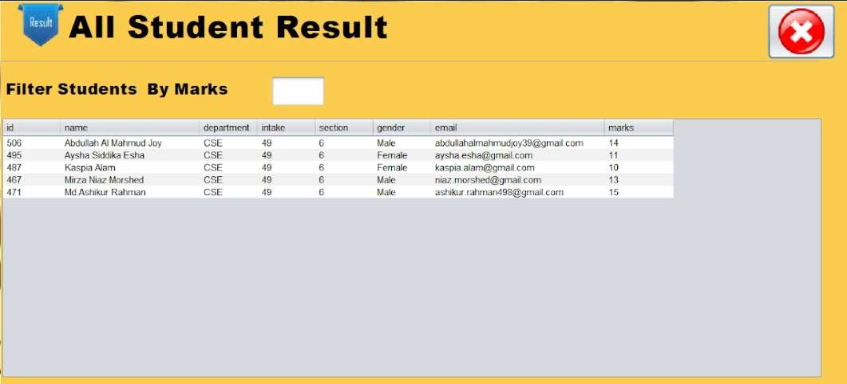
8. All Student Result Class:
- Purpose: Offers teachers an overview of all student results. - Functionality: Presents a comprehensive list of student scores and performance metrics for analysis.

Slide 15
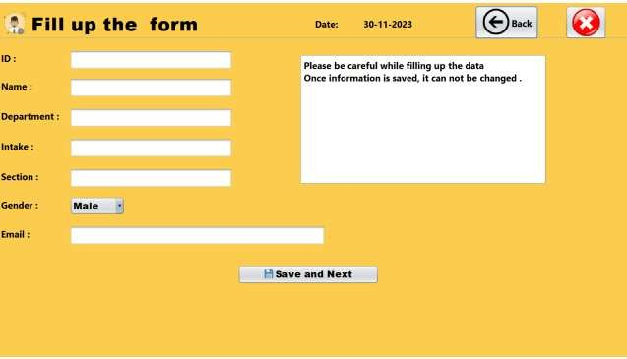
9. Student Details Class:
- Purpose: Collects necessary information from students before entering the quiz. - Functionality: Prompts students to input required details, such as name and class, to personalize the quiz experience.

Slide 16
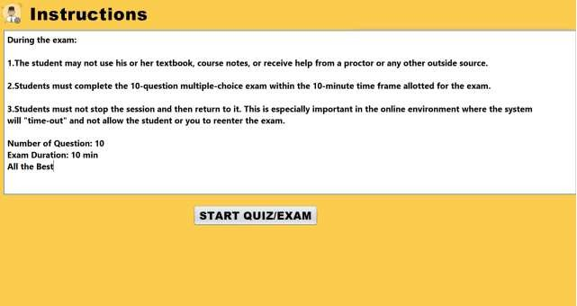
10. Instructions Class:
- Purpose: Provides guidance and instructions for students before starting the quiz. - Functionality: Displays essential information, rules, and guidelines for students to follow during the quiz.

Slide 17
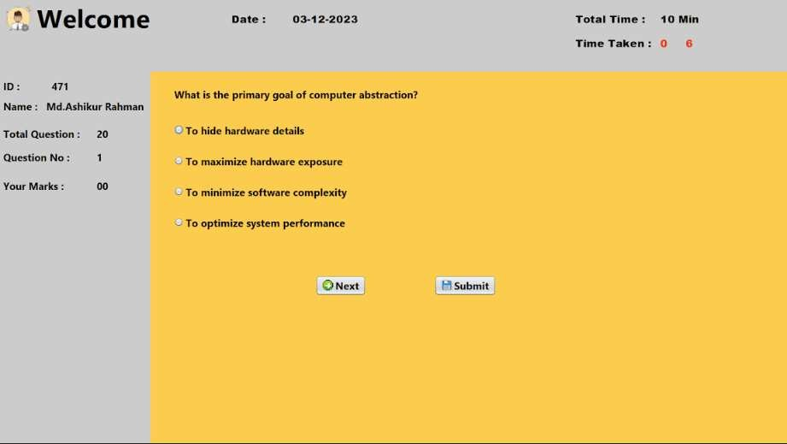
11. Quiz Exam Student Class:
Purpose: Represents the main quiz interface for students.
Functionality: Implements the quiz with multiple-choice questions, a time limit, and real-time score updates. Manages the entire quiz□taking process

Slide 18
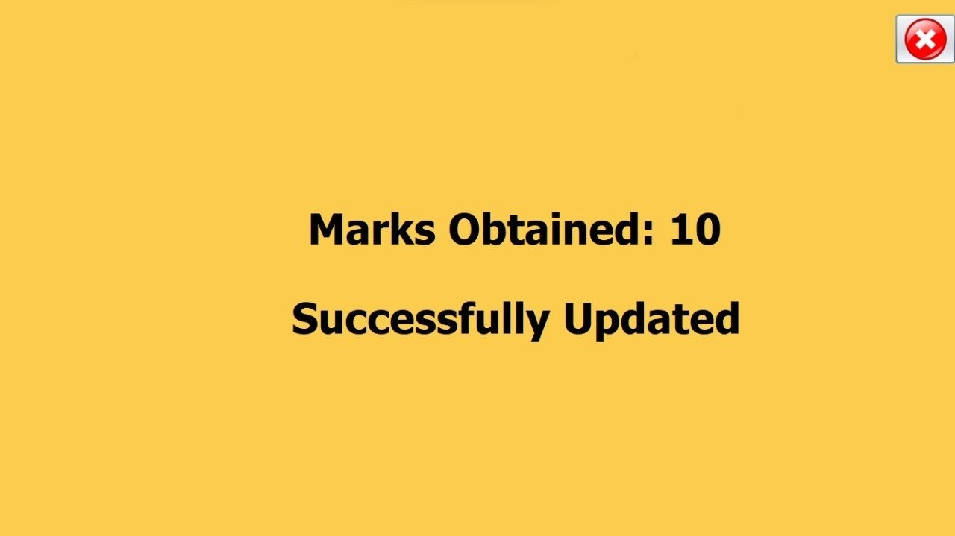
12. Successfully Submitted Class:
Purpose: Indicates successful submission of the quiz by the student.
Functionality: Displays a conﬁrmation message upon successful completion of the
quiz, acknowledging that the answers have been submitted.

Slide 19
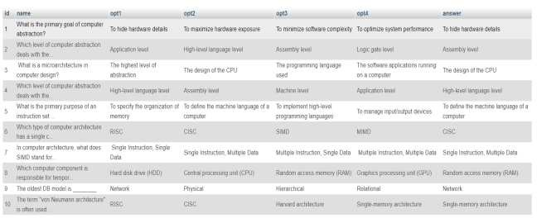
Results and discussions
Questions in Database:

Slide 20
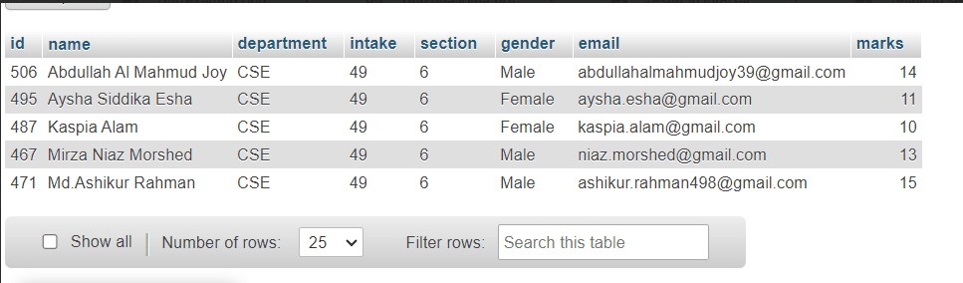
Student details and results in Database:

Slide 21

Conclusion
Our Java Quiz project is a success! We've built a smart and easy□to-use app that helps teachers and students, especially during the tough times of the COVID-19 pandemic. Using Java, SQL, and NetBeans, we created a friendly space for learning.
This project proves that technology can make education better, even when things are changing. The app's design, features, and the teamwork behind it show how tech can bring learning to life.

Slide 22






Our Quiz Management System project, guided by our teacher Md. Mahbub-Or-Rashid, reﬂects dedicated teamwork and mentorship. Throughout the project, we collaborated to design, implement, and reﬁne our solution. Our teacher’s guidance was instrumental in shaping the project’s direction and ensuring its success. The project showcases not only our technical skills but also highlights the collaborative and educational journey we undertook to bring our ideas to fruition.
Our Quiz Management System project is a testament to our strong teamwork. Collaborating seamlessly, we designed, implemented, and reﬁned our solution together. Each team member's unique skills and perspectives enriched the project, showcasing the power of collective effort in achieving success.

